Slide 1
SQL Introduction and Some Details
CSE -304
Database

Slide 2
What Is SQL?
Structured Query Language (SQL) is the language
used to interaction with a database management system
SQL provides
Querying data
Inserting, updating, and deleting rows in a table
Creating, replacing, altering, and dropping objects
Controlling access to the database, and its objects
Guaranteeing database consistency and integrity

Slide 3
SQL Statements
SQL statement | Function of the statement
SELECT | Retrieves data from database
INSERT UPDATE DELETE | Inserts data, updates data, and deletes data in database
CREATE ALTER DROP | Creates new tables in database, alters existing tables, deletes tables from database
COMMIT ROLLBACK | Saves data permanently in database, erases changes done form database

Slide 4
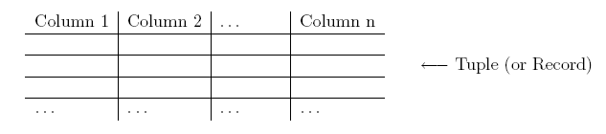
Tables
In relational database systems data are represented using tables (relations).
A query issued against the database also results in a table.
A table has the following structure:
SQL uses the terms table, row, and column for relation, tuple, and attribute, respectively.

Slide 5
The HR Schema
The Human Resource (HR) schema is a part of Oracle sample database
Installed with Oracle
This course uses the tables in HR schema for all practice and homework sessions

Slide 6
The HR Schema
REGIONS – contain rows that represent a region such as America, Asia, and so on.
COUNTRIES – contain rows for countries each of which is associated with a region
LOCATIONS – contains the specific address of a specific office, warehouse, or a production site of a company in a particular country
DEPARTMETNS – shows detail about a department in which an employee works. Each department may have a relationship representing the department manager in the EMPLOYEES table.
EMPLOYEES – contain detail about each employee working for a department. Some employees may not be assigned to any department. ­­
JOBS – contain the job types that can be held by each employee.
JOB_HISTORY – contain the job history of the employees. If an employee changes department within a job, or changes a job within a department, a new row is inserted in this table with the earlier job information of the employee.

Slide 7
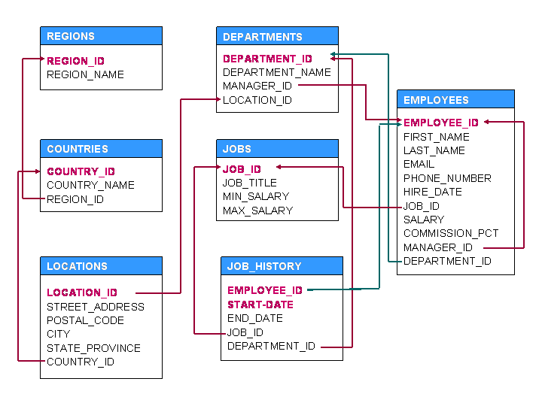
The HR Schema

Slide 8
Use of DESCRIBE Statement
DESCRIBE statement to view the structure,
Column names and
Data types of different columns of a table
Issue the following query:
DESC EMPLOYEES ;

Slide 9
Basic data types
char(n):
Fixed‐length character data (string), n characters long.
The maximum size for n is 2000 bytes.
Note that a string of type char is always padded on right with blanks to full length of n. (memory consuming)
Example: char(40)
varchar2(n):
Variable‐length character string.
The maximum size for n is 4000 bytes.
Only the bytes used for a string require storage.
Example: varchar2(80)

Slide 10
Basic data types
number(o, d):
Numeric data type for integers and reals.
o is the precision= total number of significant digits
d is the scale = the number of digits from the decimal point to the least significant digit
Examples: number(8), number(5,2)
Note that, number(5,2) cannot contain anything larger than 999.99 without resulting in an error.
Data types derived from number are int[eger], dec[imal], smallint, float and real.

Slide 11
Number examples
The value 7,456,123.89 will display as follows:
– number(9) | 7456124
– number(9,1) | 7456123.9
– number(*,1) | 7456123.9
– number(9,2) | 7456123.89
– number(6) | [not accepted exceeds precision]
– number(7,‐2) | 7456100
– number | 7456123.89
– float | 7456123.89

Slide 12
Number format
number(o, d):
positive scale (d) is the number of digits to the right of the decimal point including the least significant digit which is the right‐most digit after the decimal point
negative scale (d) is the number of significant digits to the left of the decimal point, to but not including the least significant digit.
For positive scale (d) the least significant digit actual data is rounded to the specified number of places to the right or left of the decimal point.
For example, a specification of (10,‐2) means to round to hundreds.

Slide 13
Basic data types
date:
Date data type for storing date and time.
The default format for a date is: DD‐MMM‐YY.
– Examples: ’13‐OCT‐94’, ’07‐JAN‐98’
long:
Character data up to a length of 2GB.
In Oracle‐SQL there is no data type boolean. It can, however, be simulated by using either char(1) or number(1).

Slide 14
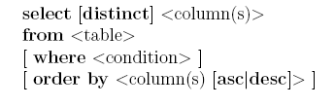
Queries
In SQL a query has the following (simplified) form (components in brackets [ ] are optional):

Slide 15
Select Statement
Remember the followings:
All SQL statements have a terminator, i.e., semicolon (;) at the end
SQL Keywords are NOT case-sensitive, e.g.,
SELECT, Select, and select are all same.
SQL statements can be entered in one or more lines to increase readability

Slide 16
Select Statement
Remember the followings:
All SQL statements have a terminator, i.e., semicolon (;) at the end
SQL Keywords are NOT case-sensitive, e.g.,
SELECT, Select, and select are all same.
SQL statements can be entered in one or more lines to increase readability

Slide 17
Queries
The columns to be selected from a table are specified after the keyword select. This operation is also called projection.
select LOCATION_ID, DEPARTMENT_NAME from DEPARTMENTS;
If all columns should be selected, the asterisk symbol ‘*’ can be used to denote all attributes.
select * from EMPLOYEES;
Instead of an attribute name, the select clause may also contain arithmetic expressions involving arithmetic operators etc.
select FIRST_NAME, DEPARTMENT_ID, SALARY*1.55 from EMPLOYEES;

Slide 18
Queries : distinct
Consider the query
select DEPARTMENT_ID from EMPLOYEES;
It retrieves the department number for each tuple.
Typically, some numbers will appear more than only once in the query result, that is, duplicate result tuples are not automatically eliminated.
Inserting the keyword distinct after the keyword select, however, forces the elimination of duplicates from the query result.
select distinct(DEPARTMENT_ID) from EMPLOYEES;

Slide 19
Queries : order by
It is also possible to specify a sorting order in which the result tuples of a query are displayed.
For this the order by clause is used and which has one or more attributes listed in the select clause as parameter. desc specifies a descending order and asc specifies an ascending order (this is also the default order).
For example,
– select FIRST_NAME, DEPARTMENT_ID, HIRE_DATE
from EMPLOYEES
order by DEPARTMENT_ID [asc], HIRE_DATE desc;

Slide 20
Queries : where clause
If one is interested in tuples that satisfy certain conditions, the where clause is used.
List the job title and the salary of those employees who earn more than 2500:
select JOB_ID, SALARY from EMPLOYEES
where SALARY > 2500;
List the job id and the salary of those employees who earn more than 1500 and whose manager has the number 7698 or 7566
select JOB_ID, SALARY from EMPLOYEES where (MANAGER_ID = 120 or MANAGER_ID = 123) and SALARY > 1500;

Slide 21
Queries : where clause
For all data types, the comparison operators =, != or <>,<,
>,<=, => are allowed in the conditions of a where clause.
Further comparison operators are:
Set Conditions: <column> [not] in (<list of values>)
select * from DEPARTMENTS where DEPARTMENT_ID in (20,30);
Null value: <column> is [not] null,
i.e., for a tuple to be selected there must (not) exist a defined value for this column.
select * from EMPLOYEES where MANAGER_ID is not null;
Note: the operations = null and ! = null are not defined!

Slide 22
Queries : where clause
Domain conditions: <column> [not] between <lower bound> and <upper bound>
select EMPLOYEE_ID, FIRST_NAME, SALARY from EMPLOYEES where SALARY between 1500 and 2500;
select LAST_NAME from EMPLOYEES where HIRE_DATE between ’02‐ APR‐81’ and ’08‐SEP‐81’;

Slide 23
Aggregation
Count ‐ Counting Rows
How many tuples are stored in the relation EMP?
select count(*) from EMPLOYEES;
How many different job titles are stored in the relation EMP?
select count(distinct JOB_ID) from EMPLOYEES;
Sum ‐ Computes the sum of values (only applicable to the data type number)
Find the sum of all salaries of employees working in the department 30.
select sum(SALARY) from EMPLOYEES where DEPARTMENT_ID = 30;

Slide 24
Aggregation
Max/Min – Maximum/Minimum value for a column
List the minimum and maximum salary.
select min(SALARY), max(SALARY) from EMPLOYEES;
Compute the difference between the minimum and maximum salary.
select max(SALARY) ‐ min(SALARY) as difference from EMPLOYEES;
15
•

Slide 25
Aggregation
Avg ‐ Computes average value for a column (only applicable to the data type number)
Find the average salaries of employees working department 10.
– select avg(SALARY) from EMPLOYEES where DEPARTMENT_ID = 80;
Ignores
tuples
that have a null value
for the
specified
attribute.
It is not possible to use aggregation of aggregation. So max(avg(..)) is not possible.

Slide 26
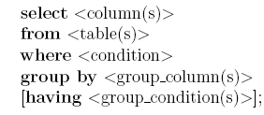
Group By
We have seen how aggregate functions can be used to compute a single value for a column.
Often applications require grouping rows that have certain properties and then applying an aggregate function on one column for each group separately.
For this, SQL provides the clause group by <group column(s)>. This clause appears after the where clause and must refer to columns of tables listed in the from clause.

Slide 27
Group By
Those rows retrieved by the selected clause that have the same value(s) for <group column(s)> are grouped.
Aggregations specified in the select clause are then applied to each group separately.
It is important that only those columns that appear in the
<group column(s)> clause can be listed without an aggregate function in the select clause.
For each department, we want to retrieve the minimum and maximum salary.
– select DEPARTMENT_ID, min(SALARY), max(SALARY) from EMPLOYEES group by DEPARTMENT_ID;

Slide 28
Group By
Note that is not allowed to specify any other column than DEPARTMENT_ID without an aggregate function in the select clause since this is the only column listed in the group by clause.
finds the maximum and minimum salary for each job types for only the employees working in the department no. 80
SELECT JOB_ID, MAX(SALARY), MIN(SALARY)
FROM EMPLOYEES
WHERE DEPARTMENT_ID = 80
GROUP BY JOB_ID ;

Slide 29
Group By/Having
Once groups have been formed, certain groups can be eliminated based on their properties, e.g., if a group contains less than three rows.
This type of condition is specified using the having clause. As for the select clause also in a having clause only <group column(s)> and aggregations can be used.
Retrieve the minimum and maximum salary of clerks for each department having more than two ST_CLERKS.
– select DEPARTMENT_ID, min(SALARY), max(SALARY) from EMPLOYEES where JOB_ID = ’ST_CLERK’ group by DEPARTMENT_ID having count(*) > 2;

Slide 30
Group By/Having
A query containing a group by clause is processed in the following way:
Select all rows that satisfy the condition specified in the where clause.
From these rows form groups according to the group by clause.
Discard all groups that do not satisfy the condition in the having clause.
Apply aggregate functions to each group.
Retrieve values for the columns and aggregations listed in the select clause.

